Slide 1
Interference Level 4/5 Group 20
Max Carter
Charlie Crewe
Joe Sawyer
Ethan Ward
Quwaine Dantes

Slide 2
Log Line
Survive waves of interference, through management and skill, to uncover memories of your past.

Slide 3
The Player – Our Demographic
Males
Aged 18-24
Increasing difficulty to invoke learn, practice, master

Slide 4
Obscure Sorrows (Emotions)
Adronitis
How long it takes to get to know someone.
Monachopis
The subtle but persistant feeling of being out of place.
Amnesia causes the player to not know him self
The player is in a coma, therefore they are feeling out of place

Slide 5

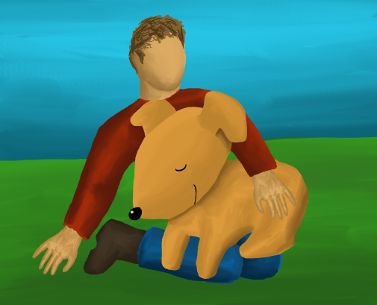
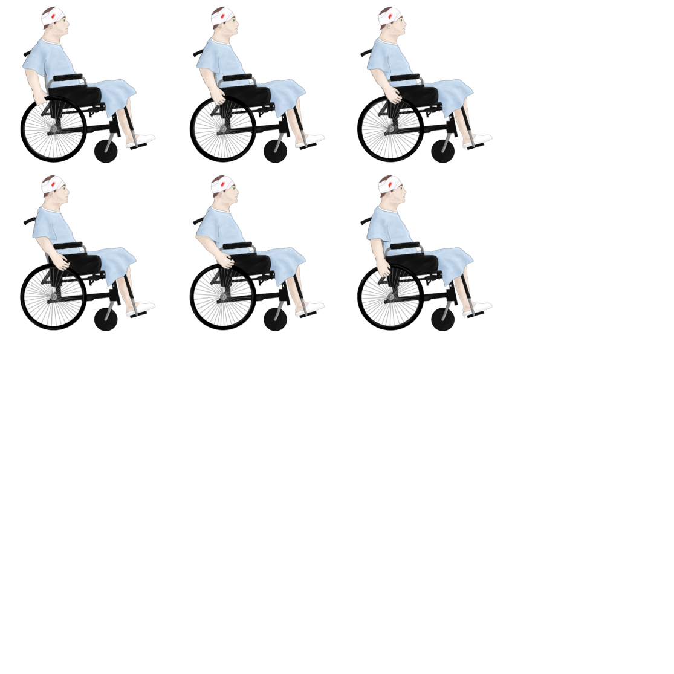

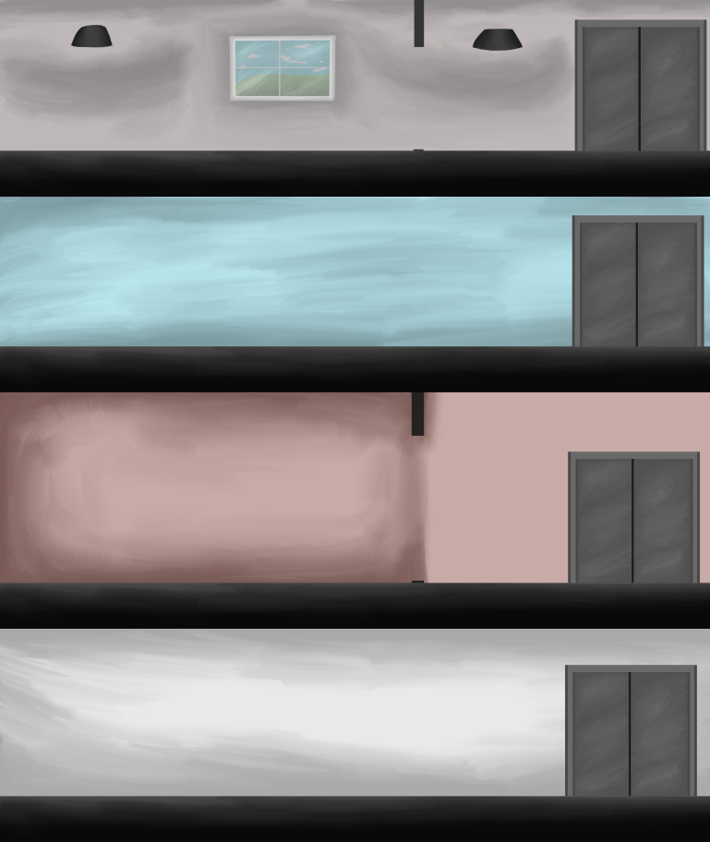
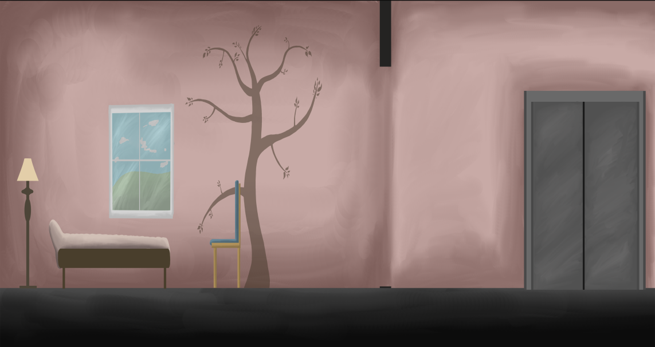
What’s Changed?

Slide 6
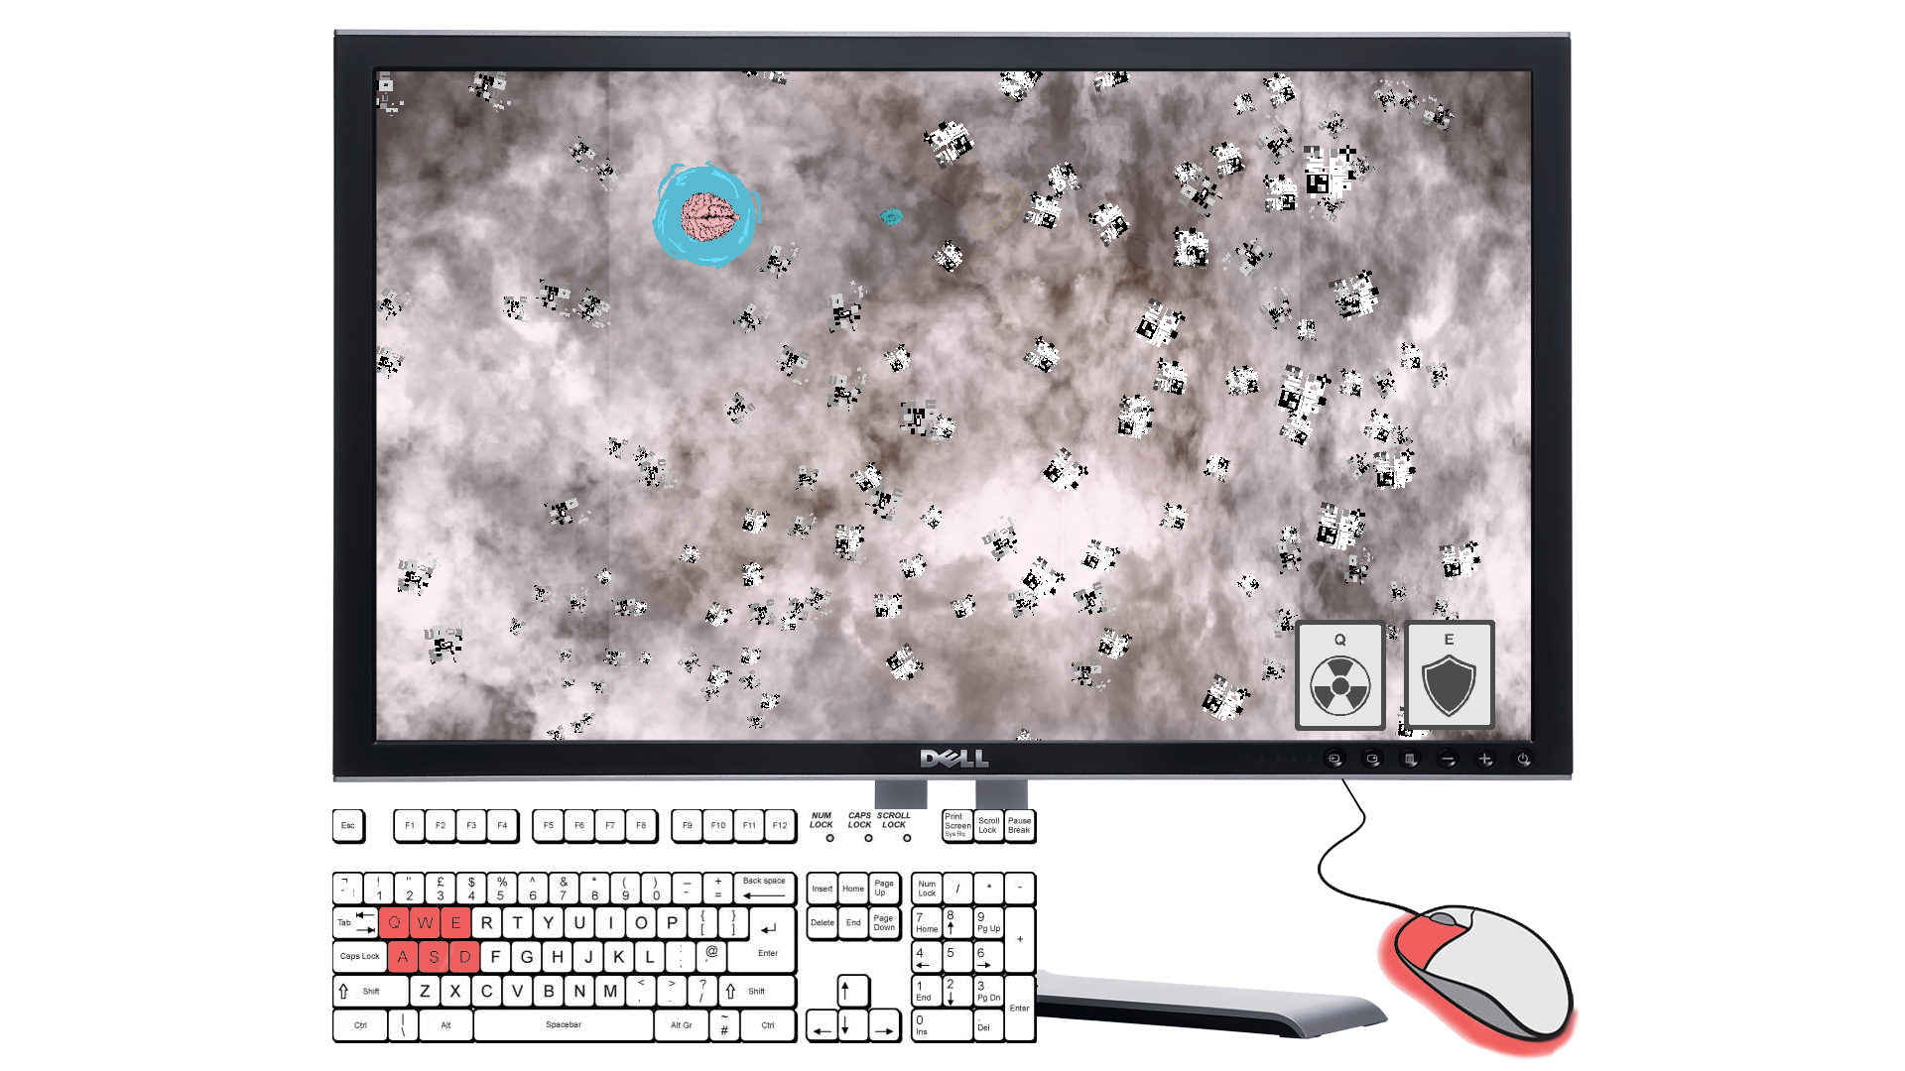
Mock-Up

Slide 7

Types of fun
Serious Fun
Repetition, Learn-Practice-Master, Rhythm, Strategy, Goals
Hard Fun
Win, Challenge, Power Ups, Frustration, Fiero

Slide 8
Thank you for listening...
Questions?

